Slide 1
PGR Rep cheat sheet
What is expected
What is optional
Team
Run and organize SSLC meetings
Attend FSSLC meetings
Represent students if required
PGR satisfaction Survey
School assembly meetings
Geography facility meetings
Organizing people
Anything else
Team
Individuals

Slide 2
SSLC Meeting timeline
FSSLC Meeting
Two weeks ahead
Create form/survey and send it around students in order to collect their feedback
Appoint chair
One week – one day ahead
Close the form/survey, organize the feedback
Go through last meetings minutes and check all actions
Go through Education Action Plan (EAP) and check on the points
Create a schedule for SSLC
Send reminder to the students
One week – one day ahead
Attend pre-SSLC meeting to announce the schedule to the staff
On the day
Organize social for the evening
Send Reminder to the students about the meeting
Just turn up, join the discussion if needed.

Slide 3
What is optional
Budget
Monthly socials
Christmas secret Santa and party
Browns weekend away
£2000
LINK TO BUDGET SPENDING TOOL
What needs to be done in Browns throughout a year
Fetch Coffee & Milk
Fetch printer paper
Buy biscuits
Wash tea towels and blankets
Clean the fridge
Refresh the student board
Take care of plants > Browns Plant Collective
Keep on top of any hoarding
By anyone, not just a Rep

Slide 4
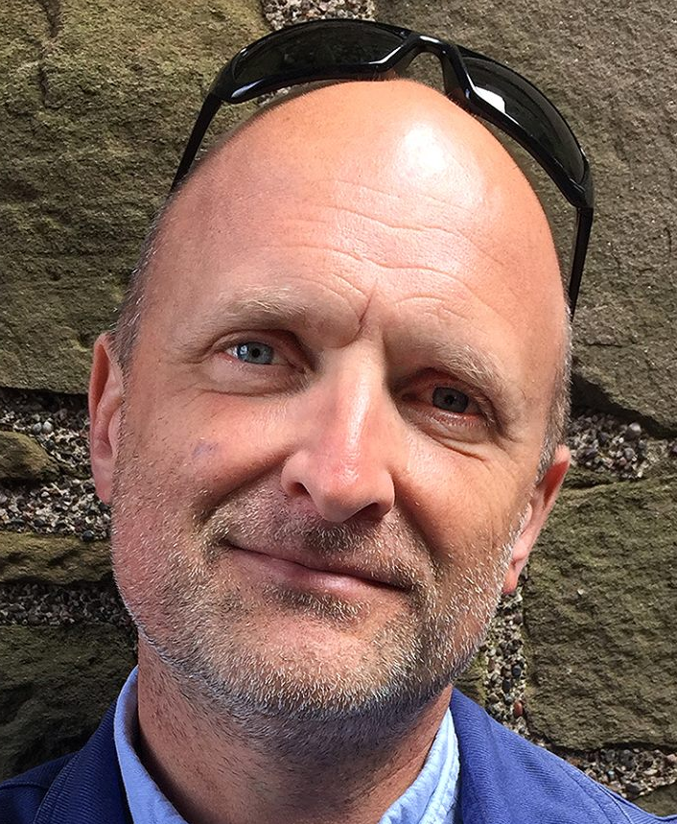
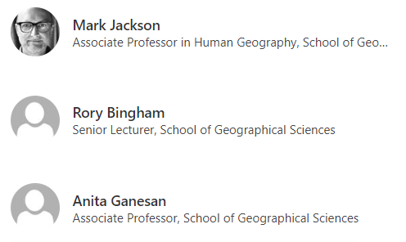
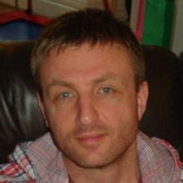
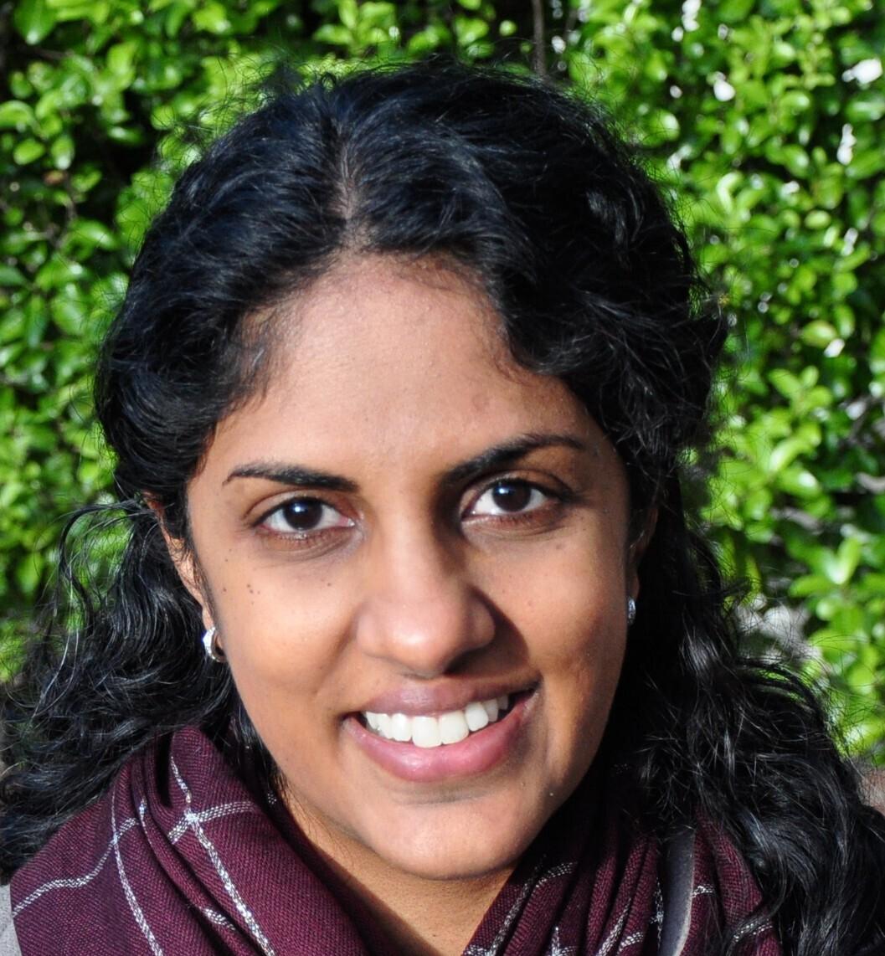

Important people
Academic staff
Human Geography PGR director
Physical Geography PGR director
MSc & MScR director
Head of School

Slide 5
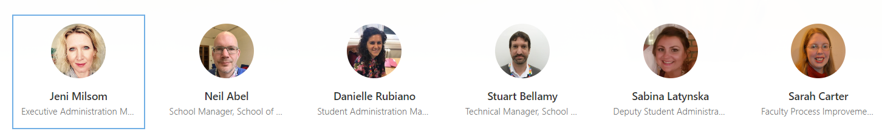
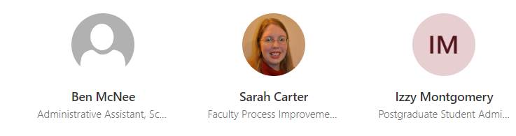
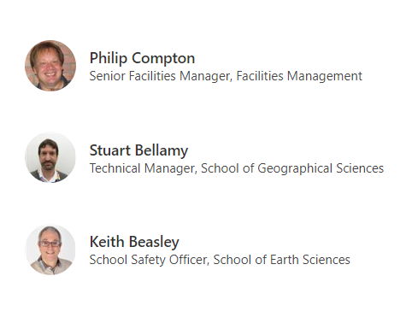
Important people
Non-Academic staff
?
1
Cleaning lady in main department
She can give us tea, coffee, milk, and cleaning supplies
Executive administrator
Can help with travel budget issues
Can order cleaning supplies for us
Monica
Finances, he approves the PGR social budget
Can help with travel budget issue
1
Health & Safety officer, approves the Risk assessment (only necessary wen organizing event inside uni building and with more than 30 people)

Slide 6
GEOGBROWNS.COM
Github
https://github.com/geogbristol/geogbrowns
Access needs to be granted individually
Email
geogbrowns@gmail.com
Password: university34
Netlify
https://www.netlify.com/
geogbrowns@gmail.com
Password: 6hp25HRw4m*c
Domain
geogbrowns.info
For now owned by Lenka
£5 a year

